Slide 1








STOCK VISION
- A Smart Real-Time Stock Visualizer and Forecaster

Slide 2

TEAm details
H. DHEERAJ KISHORE
G. HEMANANDAN REDDY
T. AKASH REDDY
G. GEETHA VINAY KRISHNA
99220040269
99220040265
99220040209
99220040267
Guided By:
Mrs. R. Durga Meena
(Asst. Professor)

Slide 3


Problem statement
The problem statement is to address the challenge of accurately predicting stock prices due to the dynamic and complex nature of financial markets. Inadequate forecasting leads to financial losses and missed opportunities, affecting investors and economic stability. Reliable methods are needed for informed decision-making and risk management. This aligns with UN Sustainable Development Goal 8, promoting economic growth through enhanced financial forecasting.

Slide 4

Introduction
Our project features a single-page web application that provides real-time financial data visualization using the Dash library and yfinance. It integrates advanced machine learning algorithms for accurate stock price predictions. With its user-friendly interface, the app helps investors make informed decisions and navigate market fluctuations effectively. This tool combines dynamic data insights with predictive analytics to support strategic investment strategies.

Slide 5



OBjectives
Enables dynamic data visualization for interactive displays.
Provides accurate forecasting for reliable future trends.
Integrates predictive analytics to enhance data analysis.
Offers a user-friendly interface for easy navigation.
Ensures comprehensive data integration from various sources.
Supports performance evaluation to measure efficiency.
Delivers real-time updates for continuously refreshed insights.
Assists in decision support for informed business choices.

Slide 6



FINANCIAL LITERACY
Benefits
to the Community
Enhances community knowledge about stock markets and investment strategies.
RISK REDUCTION
Provides tools to manage financial risks, protecting personal and communal wealth.
BETTER INVESTMENT DECISIONS
LOCAL ECONOMIC GROWTH
Empowers community members to make informed decisions, potentially increasing financial stability.
Encourages more informed investments, potentially boosting local businesses and economies.

Slide 7
Literature survey
S.No. | Title | Authors | Journal | Methodology | Research Gap
1 | Improving stock market prediction accuracy using sentiment and technical analysis (2024) | Shubham Agrawal, Nitin Kumar, Geetanjali Rathee, Chaker Abdelaziz Kerrache, Carlos T. Calafate & Muhammad Bilal | Electronic Commerce Research | The study employs a reinforced model that integrates sentiment analysis of tweets with technical indicators to predict stock market trends, tested on stock data from companies across different sectors. | While previous studies have focused on social media sentiment alone, this research fills the gap by combining sentiment with technical analysis for enhanced stock price prediction accuracy.
2 | Stock Market Prediction Using LSTM(2024) | Abhishek Kothari, Atharv Kulkarni, Tejas Kohade & Chetan Pawar | Smart Trends in Computing and Communications | The study applies LSTM neural networks, incorporating nine predictors from market fundamentals, macroeconomics, and technical indicators to forecast NSE stock prices, evaluated through metrics like RMSE, MAPE, and correlation coefficient. | Previous models often focus on simpler approaches, whereas this research integrates multiple predictors with advanced LSTM techniques for improved stock market prediction accuracy.
3 | Stock market prediction with political data Analysis (SP-PDA) model for handling big data(2024) | Yalanati Ayyappa & A. P. Siva Kumar | Multimedia Tools and Applications | The study introduces the SP-PDA model, which integrates stock, news, and political data with an ensemble of machine learning classifiers, optimized using the DMUWS-based GND algorithm for stock market prediction. | This research fills the gap by incorporating political data and advanced optimization techniques, improving prediction accuracy compared to traditional models.

Slide 8
Literature survey
S.No. | Title | Authors | Journal | Methodology | Research Gap
4 | Stock Market Prediction Using Social Media Sentiments(2024) | Ayush Upadhyay, Harsh Jain, Prateek Dhingra, Nisha Kandhoul, Sanjay K. Dhurandher & Isaac Woungang | Complex, Intelligent and Software Intensive Systems | The study develops the TBHAG model, combining TextBlob sentiment analysis of Twitter data with a hybrid ARIMA-GARCH model to predict stock movement for NIFTY 50. | While previous models largely omit sentiment integration, this research addresses the gap by incorporating investor sentiment with traditional time series models for improved stock market prediction accuracy.
5 | Stock Market Prediction Using ML Module(2024) | Sonal Jathe & D. N. Chaudhari | Artificial Intelligence: Theory and Applications | The study utilizes granular daily stock data at five-minute intervals from NSE to build regression and classification models using a combination of statistical and machine learning techniques for risk- adjusted stock price prediction. | While prior approaches often overlook fine- grained data and risk analysis, this research addresses the gap by integrating high- frequency data with machine learning for more robust and risk-averse stock prediction models.
6 | Stock Market Prediction Using Machine Learning: Evidence from India Chapter(2024) | Subhamitra Patra, Trilok Nath Pandey & Biswabhusan Bhuyan | Machine Learning Approaches in Financial Analytics | The study predicts Indian stock market movements (2000–2022) using machine learning models, with Long Short-Term Memory (LSTM) demonstrating superior accuracy compared to Support Vector Machines and linear regression. | While previous studies showed varying accuracy across models, this research highlights LSTM's robustness in predicting emerging markets, addressing the gap in understanding model performance over long periods and different market conditions

Slide 9
Literature survey
S.No. | Title | Authors | Journal | Methodology | Research Gap
7 | A Stock Price Prediction Method Based on BiLSTM and Improved Transformer (2023) | Shuzhen Wang | Institute of Electrical and Electronics Engineers | Integrates (BiLSTM) with enhanced (MTRAN-TCN) to leverage bidirectional sequence information, full-range distance insights, improve sequence dependency capture for stock price prediction. | Existing methods focus on single- model approaches the BiLSTM- MTRAN-TCN method addresses the limitations of traditional models by combining advanced techniques for superior accuracy, generalization, and stability in stock price forecasting.
8 | Reinforcement Learning for Stock Prediction and High-Frequency Trading With T+1 Rules(2022) | Weipeng Zhang, Tao Yin, Yunan Zhao, Bing Han, Huanxi Liu | Institute of Electrical and Electronics Engineers | It employs rolling model training and reinforcement learning with a reward- enhanced UCB algorithm to dynamically optimize trading parameters and adapt to real-time market conditions. | It addresses the limitations of static prediction models and inflexible trading strategies by introducing adaptive parameter optimization and real-time adjustment mechanisms.
9 | Decision Fusion for Stock Market Prediction: A Systematic Review(2022) | Cheng Zhang, Nilam N. A. Sjarif, Roslina B. Ibrahim | Institute of Electrical and Electronics Engineers | Systematically analyzes studies on decision fusion for stock market prediction, focusing on base learner characteristics and fusion methods, and identifies research trends over the past two decades. | Lack of comprehensive reviews that integrate decision fusion techniques with diverse data types, novel algorithms, and sentiment analysis, highlighting a need for further exploration in these areas.

Slide 10


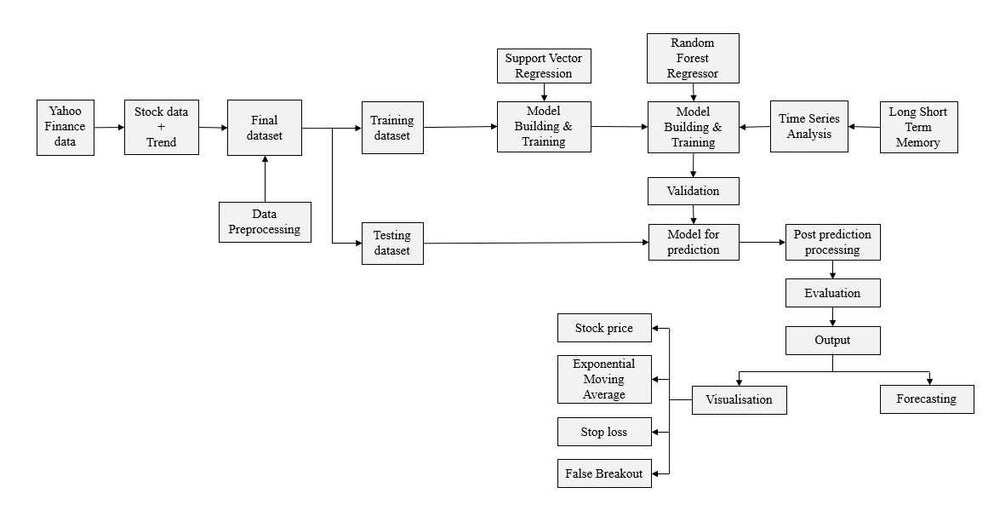
Proposed Methodology

Slide 11
Software description
Python 3.5 and above in Visual Studio code or Pycharm
Operating System: windows 7 and above or Linux based OS or MAC OS
YFINANCE
DASH
HTML/CSS
A Python library used to fetch real-time financial data from Yahoo Finance.
A Python web framework used to create interactive web applications for data visualization.
Used to design the front-end layout and style of the web application.

Slide 12

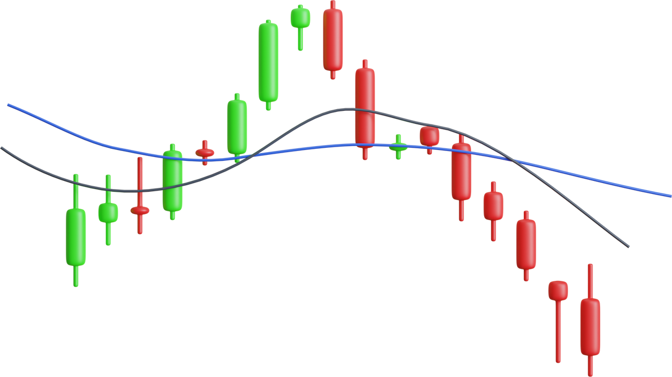
SYSTEM DESIGN
Create the Main Website Structure: Use Dash HTML and Core Components to build the layout and interactive elements of the web application.
Enhance User Interface with CSS: Apply custom CSS to style and improve the visual appeal and user experience of the site.
Fetch and Visualize Data Using Plotly: Retrieve stock market data using the yfinance library and generate interactive visualizations with Plotly.
Implement Machine Learning Model: Develop and train a machine learning model to predict future stock prices based on historical market data and user-input dates.

Slide 13


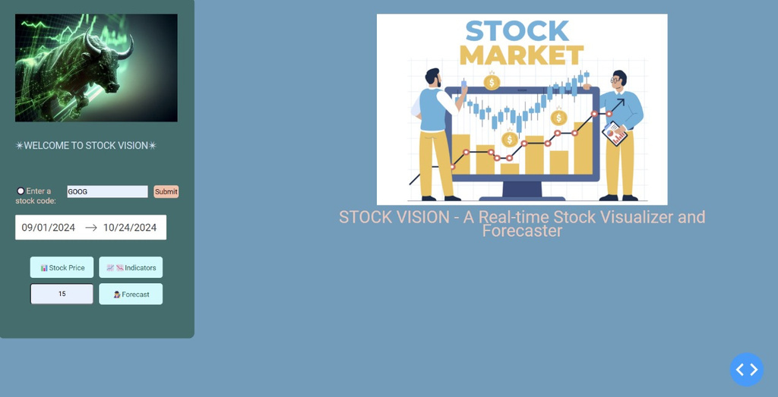
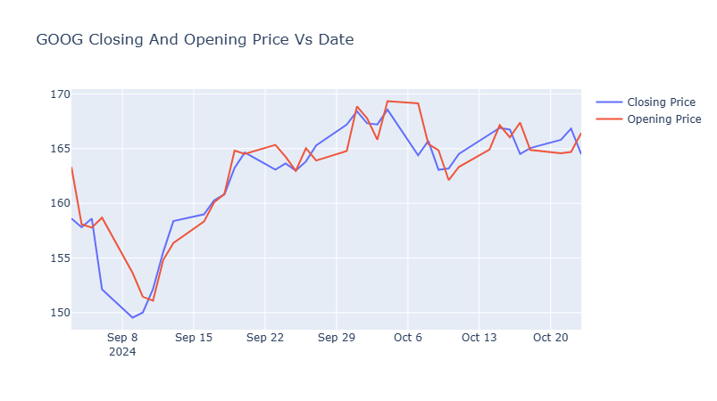

REAL TIME DEMONSTRATION
Fig.1: User Friendly Interface
Fig.2: Stock Price

Slide 14
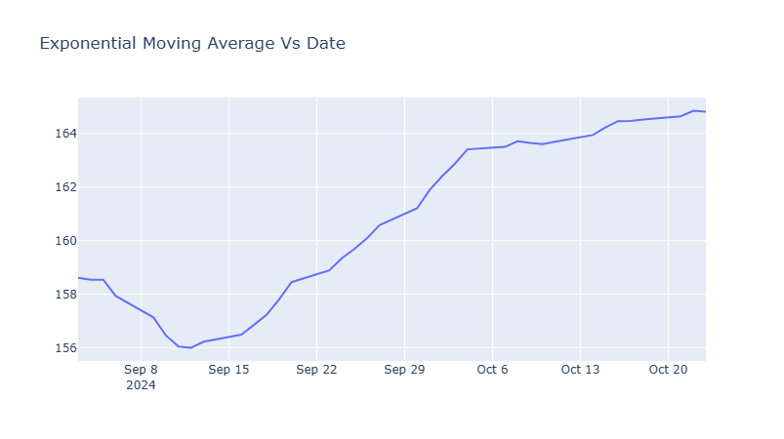
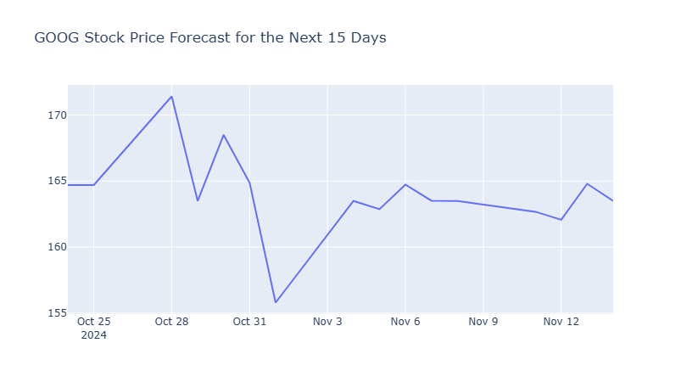
REAL TIME DEMONSTRATION
Fig.3: Exponential Moving Average
Fig.4: Price Prediction

Slide 15


references
[1] Agrawal, S., Kumar, N., Rathee, G., Kerrache, C. A., Calafate, C. T., & Bilal, M. (2024).Improving stock market prediction accuracy using sentiment and technical analysis. Electronic Commerce Research, 1-24.
[2] Kothari, A., Kulkarni, A., Kohade, T., & Pawar, C. (2024, January). Stock Market Prediction Using LSTM. In International Conference on Smart Computing and Communication (pp. 143-164). Singapore: Springer Nature Singapore.
[3] YAyyappa, Y., & Kumar, A. S. (2024). Stock market prediction with political data Analysis (SP-PDA) model for handling big data. Multimedia Tools and Applications, 1-29.
[4] Upadhyay, A., Jain, H., Dhingra, P., Kandhoul, N., Dhurandher, S. K., & Woungang, I. (2024, July). Stock Market Prediction Using Social Media Sentiments. In InternationalConference on Complex, Intelligent, and Software Intensive Systems (pp. 14-26). Cham:Springer Nature Switzerland.
[5] Jathe, S., & Chaudhari, D. N. (2023, August). Stock Market Prediction Using MLModule. In International Conference on Artificial Intelligence on Textile and Apparel(pp. 457-465). Singapore: Springer Nature Singapore.

Slide 16
references
[6] Patra, S., Pandey, T. N., & Bhuyan, B. (2024). Stock Market Prediction Using Machine
Learning: Evidence from India. In Machine Learning Approaches in Financial Analytics (pp. 347-375). Cham: Springer Nature Switzerland.
[7] Wang, S. (2023). A stock price prediction method based on BiLSTM and improved transformer. IEEE Access.
[8] Zhang, W., Yin, T., Zhao, Y., Han, B., & Liu, H. (2022). Reinforcement learning for stock prediction and high-frequency trading with T+ 1 rules. IEEE Access, 11, 14115-14127.2
[9] Zhang, C., Sjarif, N. N., & Ibrahim, R. B. (2022). Decision fusion for stock market prediction: a systematic review. IEEE Access, 10, 81364-81379.

Slide 17
conclusion
Our project features a single-page web application that provides real-time financial data visualization using the Dash library and yfinance. It integrates advanced machine learning algorithms for accurate stock price predictions. With its user-friendly interface, the app helps investors make informed decisions and navigate market fluctuations effectively. This tool combines dynamic data insights with predictive analytics to support strategic investment strategies.

Slide 18



Bringing financial insights to the community for smarter and inclusive investing
Invest now
for the future

Slide 19

Thank You

